Slide 1
CSE 453
High Performance Database Systems
Course Teacher : Md Tarikul Islam Papon

Slide 2
Distributed Computing Systems
Courtesy: Dr. Md. Yusuf Sarwar, Dr. Muhammad Abdullah Adnan

Slide 3
Distributed Systems
Distributed Systems can be defined as a collection of independent computing processes or processors, often referred to as nodes, that communicate with each other through a communication network using message passing.
Processes on nodes
do not share any memory
have independent failure modes, and
share no common clock

Slide 4
Distributed Systems
Distributed Systems can be defined as a collection of independent computing processes or processors, often referred to as nodes, that communicate with each other through a communication network using message passing.
May suffer from partitioning failure
divided into several sub-partitions, where nodes in a single partition can communicate with each other, but no communication occurs across partitions.
may occur due to both link as well as node failures, as in the case of a gateway failure.

Slide 5
Distributed Systems
Why do we distribute?
More reliable systems
More responsive systems
More efficient systems
More adaptable systems
Easier & better data management
Many of the current applications of computer technology are inherently distributed

Slide 6
What is being distributed?
Processing Logic
Function
Data
Control

Slide 7

Distributed Systems

Slide 8
Distributed Systems
State
State
Message
Distributed algorithm: a sequence of steps, including transmission and receiving of messages
Two issues-
Communication performance is a limiting characteristics
Impossible to maintain a single global notion of time
Properties of communication channel
Latency, bandwidth and jitter

Slide 9
Distributed Systems
Distributed systems are also classified into synchronous and asynchronous systems.
• Synchronous systems: take bounded (lower or/and upper) time for:
Executing each step of a process
Receiving a message after the message has been transmitted
Bounded clock drift (the variation from a real clock)
Asynchronous systems have no known bound on how much time it can take on an operation

Slide 10
Distributed Systems
Communication | Type (sync/async)
Personal greetings
Email
Voice call
Online messenger/chat
Letter correspondence
Skype call
Voice mail/voice SMS
Text messages

Slide 11
Distributed Systems
Communication | Type (sync/async)
Personal greetings | Sync
Email | Async
Voice call | Sync
Online messenger/chat | Sync ?
Letter correspondence | Async
Skype call | Sync
Voice mail/voice SMS | Async
Text messages | Async

Slide 12
Asynchrony interaction
Can A determine who sent the message earlier?

Slide 13

Asynchrony interaction
An important concept in distributed computing
Two general's problem / Two army problem
Agreement in Pepperland
Some problems are impossible to solve in asynchronous interaction/computing model

Slide 14
Failure Models
Omission and arbitrary failures
Class of failure
Affects
Description
Fail-stop
Process
Process halts and remains halted. Other processes may
detect this state.
Crash
Process
Process halts and remains halted. Other processes may
not be able to detect this state.
Omission
Channel
A message inserted in an outgoing message buffer never
arrives at the other end’s incoming message buffer.
Send-omission
Process
A process completes a
send,
but the message is not put
in its outgoing message buffer.
Receive-omission
Process
A message is put in a process’s incoming message
buffer, but that process does not receive it.
Arbitrary
Process or
Process/channel exhibits arbitrary behaviour: it may
(Byzantine)
channel
send/transmit arbitrary messages at arbitrary times,
commit omissions; a process may stop or take an
incorrect step.

Slide 15
Failure Models
Timing failures
Class of Failure
Affects
Description
Clock
Process
Process’s local clock exceeds the bounds on its
rate of drift from real time.
Performance
Process
Process exceeds the bounds on the interval
between two steps.
Performance
Channel
A message’s transmission takes longer than the
stated bound.

Slide 16
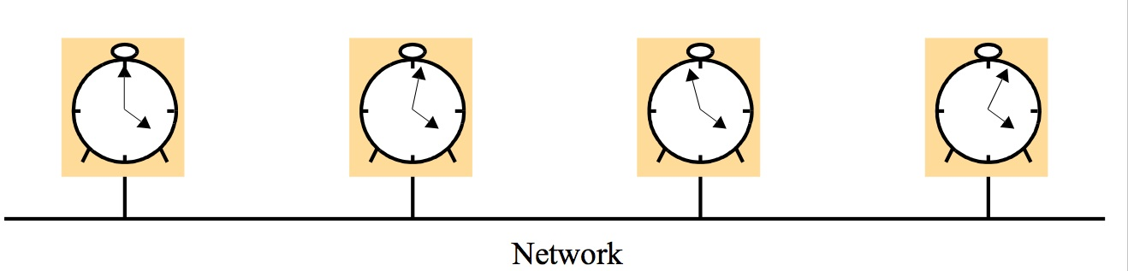
Clocks
Process events
Each process executes a series of actions
Event = an occurrence to a single action that a process carries out
Events are totally ordered in time

Slide 17
Clocks
How to “timestamp” events (across processes)?
Physical clocks are not synchronized
Two factors
Clock skew: difference in time in two clocks
Clock drift: the rate at which this difference accumulates
Coordinated Universal Time (UTC)
Caesium-133 clock
Drift rate 1 per 10¹³ seconds
Broadcast from radio stations, satellites, GPS, etc

Slide 18
Logical Time and Logical Clocks
Physical exact time is not necessary!
Lamport introduced logical clock
Events follow “happened-before” relation
If e1 → e2, then T(e1) < T(e2)
Two observations
If two events occurred at the same process, we know the exact order
Sending of a message happens before its reception
Known as “causal ordering” or partial causal ordering

Slide 19
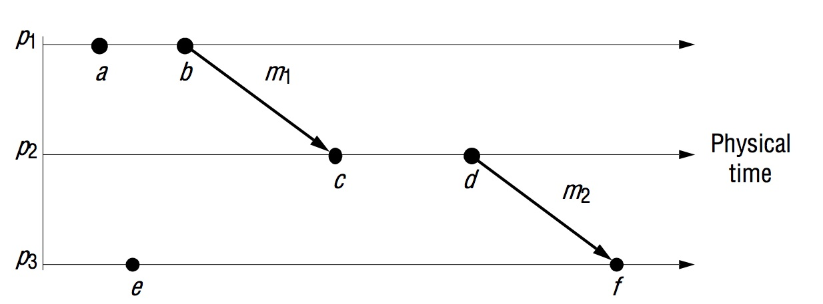
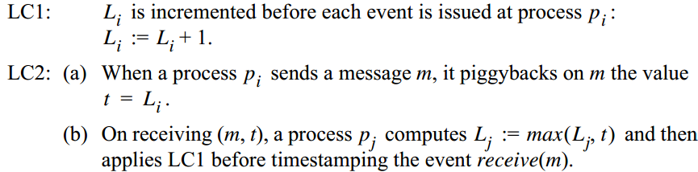
Logical Time and Logical Clocks

Slide 20
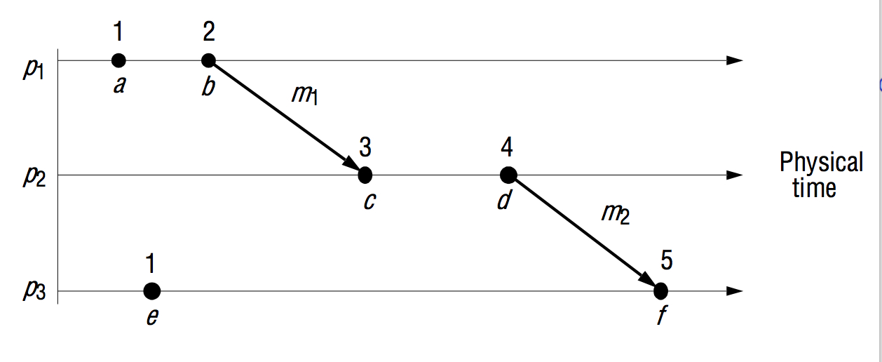
Logical Time and Logical Clocks

Slide 21
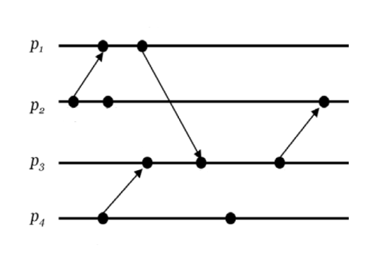
Logical Time and Logical Clocks

Slide 22
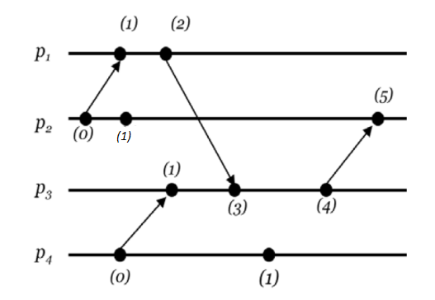
Logical Time and Logical Clocks

Slide 23
Logical Time and Logical Clocks
Logical clocks offer partial ordering
If e1 → e2, then L(e1) < L(e2)
But the converse is not true

Slide 24
Vector Clock
logical clock condition is only a necessary condition, and not necessarily sufficient. • A stronger clock condition would be one that requires for all events in the distributed system e and f : – e → f if and only if clock(e) < clock(f )
associating with each process i a vector V_{i} of length n, where n is the number of processes in the system

Slide 25
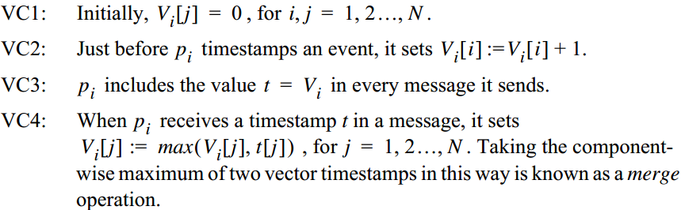
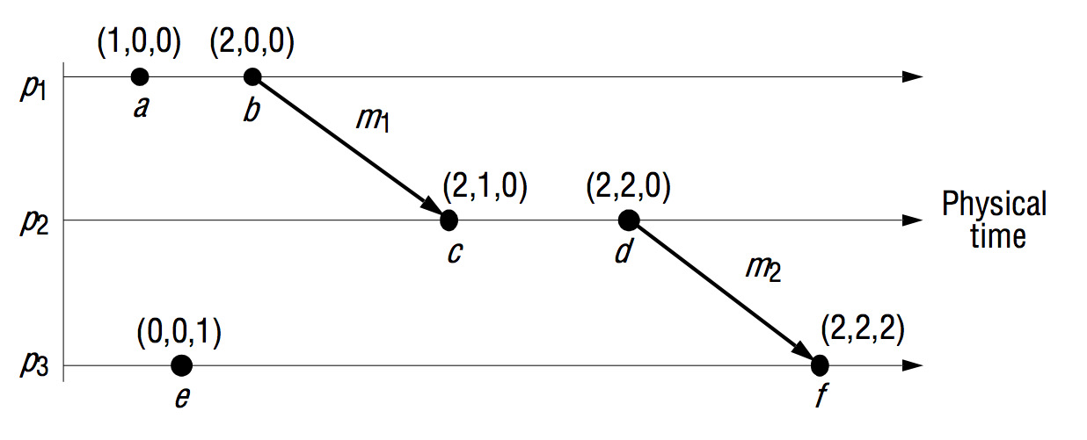
Vector Clock
Show that V(e1) < V(e2) => e1 → e2

Slide 26
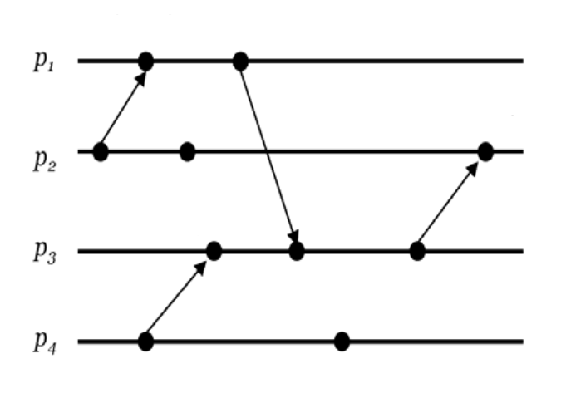
Vector Clock

Slide 27
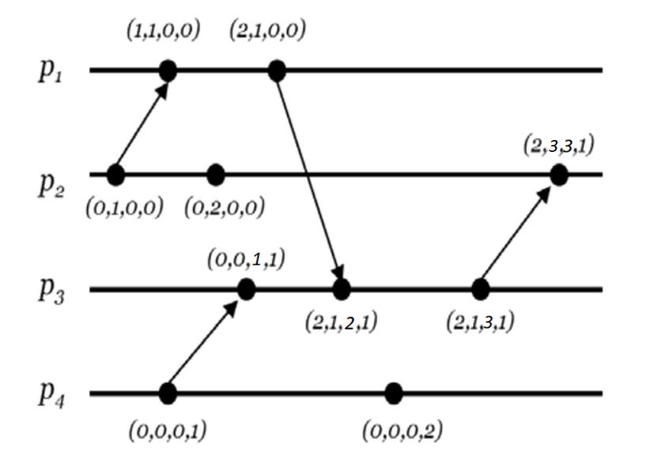
Vector Clock

Slide 28
Distributed Coordination
An operation that a set of processes collectively perform
Mutual exclusion
Allow at most one process to enter the critical section
Leader election
Exactly one process becomes the leader
Global snapshot
Ordered Multicast

Slide 29
Two Key Properties
Liveness and Safety property
Safety: Bad things never happen
Liveness: Good thing eventually happens
Example
In operating system: starvation, deadlock
Condition | Property (liveness/safety)
Criminals are caught and punished
Innocent people are not penalized
Algorithm/computation terminates
Same ticket is not issued to more than one person

Slide 30
Mutual Exclusion

Slide 31

Mutual Exclusion
Critical section/resource

Slide 32
Mutual Exclusion
Central Server Algorithm
Server
Queue of
requests
4
2
3. Grant
token
1. Request
token
2. Release
p
p
token
4
1
p
p
2
3

Slide 33
Mutual Exclusion
Central Server Algorithm
When a process wants to enter a resource, it sends a request message to the server.
If nobody is currently in the section, the coordinator sends back a grant message
Else, the server simply does not reply, so the requesting process is blocked. The server keeps track of which processes are requesting the resource (queue).
When the server receives a release(R) message, it sends a grant message to the next process in the queue for resource R.

Slide 34
Mutual Exclusion
Central Server Algorithm (Pitfalls)
Single point failure
A process cannot distinguish between being blocked (not receiving a grant because someone else is in the resource) and not getting a response because the server is down.
From the server’s side, the server does not know if a process using a resource has died, is in an infinite loop, or is simply taking a longer time to release a resource.
A centralized server can be a potential bottleneck in systems with a huge number of processes.

Slide 35
Mutual Exclusion
Ring-based Algorithm

Slide 36
Mutual Exclusion
Ring-based Algorithm
The ring is initialized by giving a token to process 0. The token circulates around the ring: process n passes it to process (n+1) mod ringsize.
When a process acquires the token, it checks to see if it is is waiting to use the resource. If so, it uses it and does its work. On exit, it passes the token to its neighboring process.
If a process is not interested in grabbing the lock on the resource, it simply passes the token along to its neighbor.

Slide 37
Mutual Exclusion
Ring-based Algorithm
Advantages
No starvation
Mutual exclusion is guaranteed
Problems
What if the token is lost?

Slide 38
Mutual Exclusion
Lamport’s Mutual Exclusion
A process that wants to use the resource sends a timestamped request for the resource to all group members as well as to itself.
Every recipient adds the received request to its request queue, which is sorted in timestamp order.
If a process sees itself at the head of the queue, it knows that it can access the resource.
When it is done, it sends a release message to all group members and removes its ID from its local queue.
Each group member, upon receiving a release message, removes that process ID from the request queue and checks to see whether it is at the head of the queue and can access the resource.

Slide 39
Mutual Exclusion
Lamport’s Mutual Exclusion
N-points failure
A lot of messaging traffic
Each request requires sending N–1 messages (one to each group member) and getting N–1 acknowledgements.
Finally, when a resource lock is released, a process must send N–1 release messages.

Slide 40
Mutual Exclusion
Ricart & Agrawala’s Algorithm
Process wants to enter CS
sends ‘requests’ to all other process and waits to receive ‘grant’ from others
Process receives ‘request’
Reply with ‘grant’ if
it is not already in CS
and
wanted to enter CS (requests sent out), but this request is earlier than its own request
Else, queue the request
Exit from CS
Send ‘grant’ to all queued requests

Slide 41
Mutual Exclusion
Ricart & Agrawala’s Algorithm
N points failure
Still a lot of messages
The Ricart & Agrawala algorithm requires 2(N-1) messages while the Lamport algorithm requires 3(N–1) messages.

Slide 42
Mutual Exclusion
Maekawa’s Algorithm
A process may not need to take ‘grant’ from all
Only from a subset should suffice
For each process p, there is a voting set, V(p)
Process that wants to enter CS needs to receive ‘grant’ from all voting set
At least one member is common in any two processes’ voting sets
i.e., V(p) ∩ V(q) ≠ empty

Slide 43
Mutual Exclusion
Fault Tolerance
Central Server
Can tolerate crash failure of a client that neither holds nor has requested the token
Ring based
Cannot tolerate any process crash failure
Maekawa’s algorithm
Tolerate crash failure who are not in any votting sets
Ricart and Agrawala algorithm
Can tolerate crash failure a process if it grants all request implicitly

Slide 44
Leader Election

Slide 45
Bully Algorithm
When a process p detects that the coordinator is not responding to requests, it initiates an election:
p sends an election message to all processes with higher numbers.
If nobody responds, then p wins and takes over.
If one of the processes answers, then p’s job is done.
If a process receives an election message from a lower-numbered process at any time, it:
sends an OK message back.
holds an election (unless its already holding one).
A process announces its victory by sending all processes a I won message telling them that it is the new coordinator.
If a process that has been down recovers, it holds an election.

Slide 46
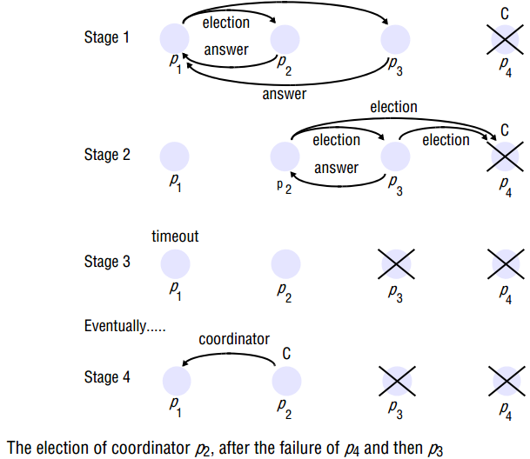
Bully Algorithm

Slide 47
Bully Algorithm

Slide 48
Bully Algorithm

Slide 49
Bully Algorithm

Slide 50
Ring-based Algorithm
If any process detects failure, it constructs an election message with its process ID and sends it to its neighbor.
If the neighbor is down, the process skips over it and sends the message to the next process in the ring. This process is repeated until a running process is located.
At each step, the process adds its own process ID to the list in the message and sends the message to its living neighbor.
Eventually, the election message comes back to the process that started it. The process then picks either the highest or lowest process ID in the list and sends out a message to the group informing them of the new coordinator.

Slide 51
Global Snapshot

Slide 52
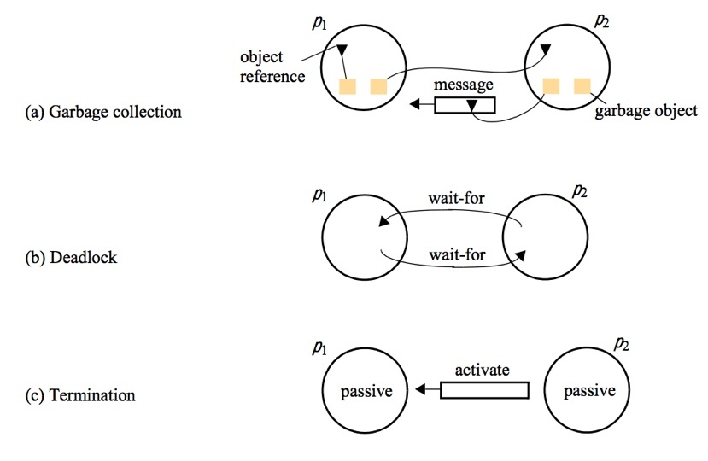
Why Snapshot?

Slide 53

Global Snapshot?

Slide 54
Global Snapshot?
Each distributed application has a number of processes (leaders) running on a number of physical servers
These processes communicate with each other via channels (text messaging)
A snapshot captures the local states of each process (e.g., program variables) along with the state of each communication channel

Slide 55
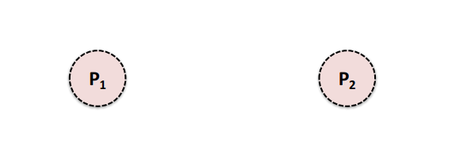
Global Snapshot?
Two processes: P1 and P2

Slide 56
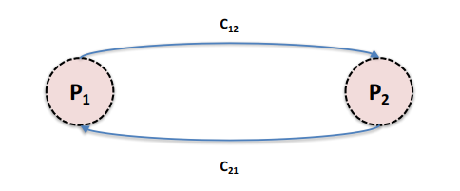
Global Snapshot?
Channel C12 from P1 to P2
Channel C21 from P2 to P1

Slide 57
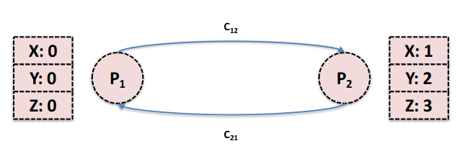
Global Snapshot?
Process states for P1 and P2

Slide 58
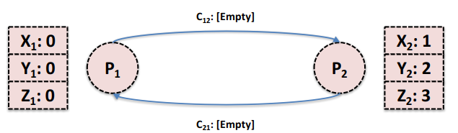
Global Snapshot?
Channel states (i.e., messages) for C12 and C21
This is our initial global state
This is a global snapshot

Slide 59
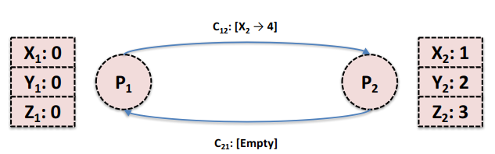
Global Snapshot?
P1 tells P2 to change its state variable, X2 from 1 to 4
This is another global snapshot

Slide 60
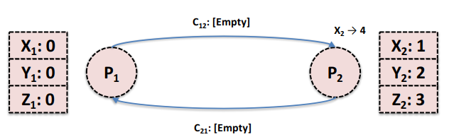
Global Snapshot?
P2 receives the message from P1
Another global snapshot

Slide 61
Global Snapshot?
P2 receives the message from P1
Another global snapshot

Slide 62
Global Snapshot?
P2 changes its state variable, X2, from 1 to 4
And another global snapshot

Slide 63
Global Snapshot?
The global state changes whenever an event happens – Process sends message – Process receives message – Process takes a step
Moving from state to state obeys causality

Slide 64
Chandy-Lamport Algorithm
Problem: record a global snapshot (state for each process and channel)
Model – N processes in the system with no failures – There are two FIFO unidirectional channels between every process pair (Pi → Pj and Pj → Pi) – All messages arrive, intact, not duplicated

Slide 65
Chandy-Lamport Algorithm
Initiating a snapshot
Let’s say process Pi initiates the snapshot
Pi records its own state and prepares a special marker message (distinct from application messages)
Send the marker message to all other processes (using N-1 outbound channels)
Start recording all incoming messages from channels C_{ji} for j not equal to i

Slide 66
Chandy-Lamport Algorithm
Propagating a Snapshot
For all processes Pj (including the initiator), consider a message on channel Ckj
If we see marker message for the first time – Pj records own state and marks Ckj as empty – Send the marker message to all other processes (using N-1 outbound channels) – Start recording all incoming messages from channels Clj for l not equal to j or k
Else add all messages from inbound channels since we began recording to their states

Slide 67
Chandy-Lamport Algorithm
Terminating a snapshot
All processes have received a marker (and recorded their own state)
All processes have received a marker on all the N-1 incoming channels (and recorded their states)
Later, a central server can gather the partial state to build a global snapshot

Slide 68
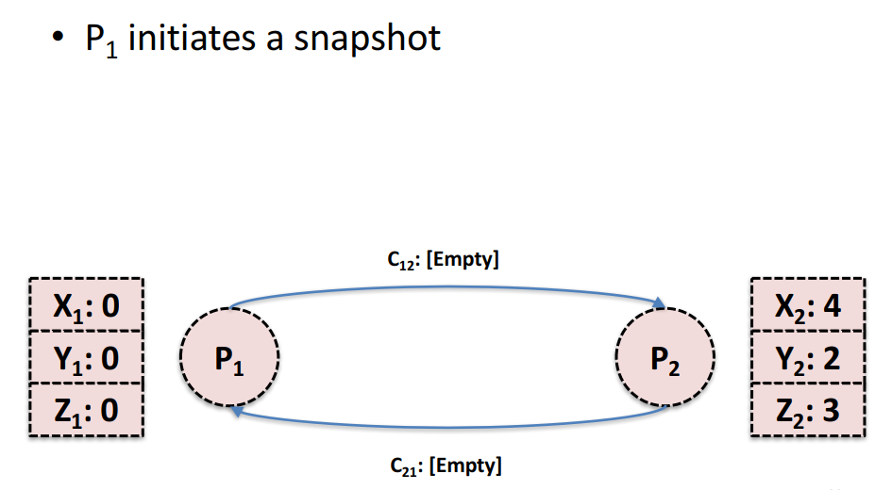
Chandy-Lamport Algorithm

Slide 69
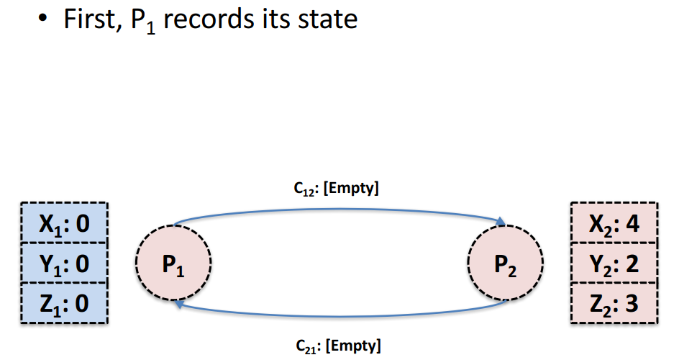
Chandy-Lamport Algorithm

Slide 70
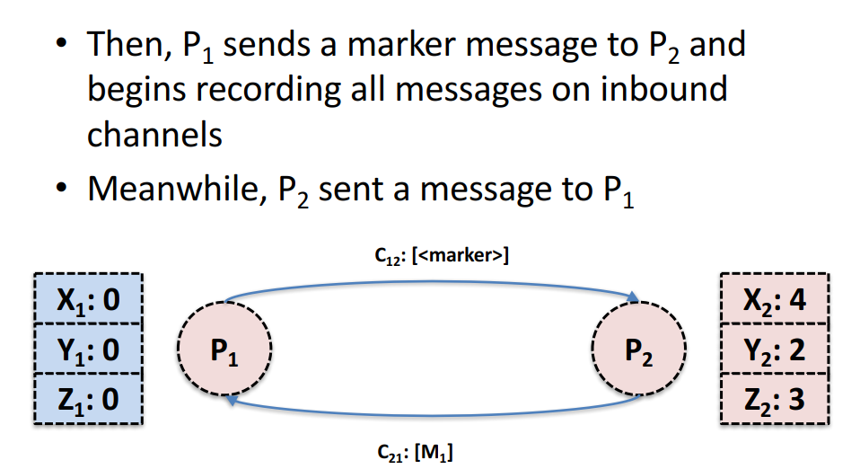
Chandy-Lamport Algorithm

Slide 71
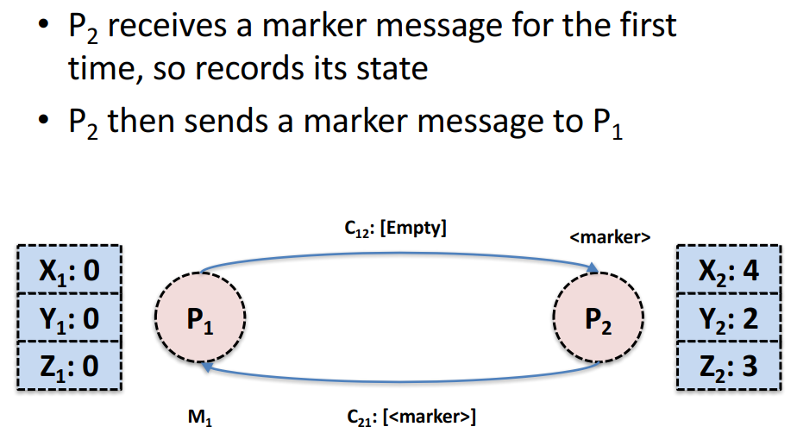
Chandy-Lamport Algorithm

Slide 72
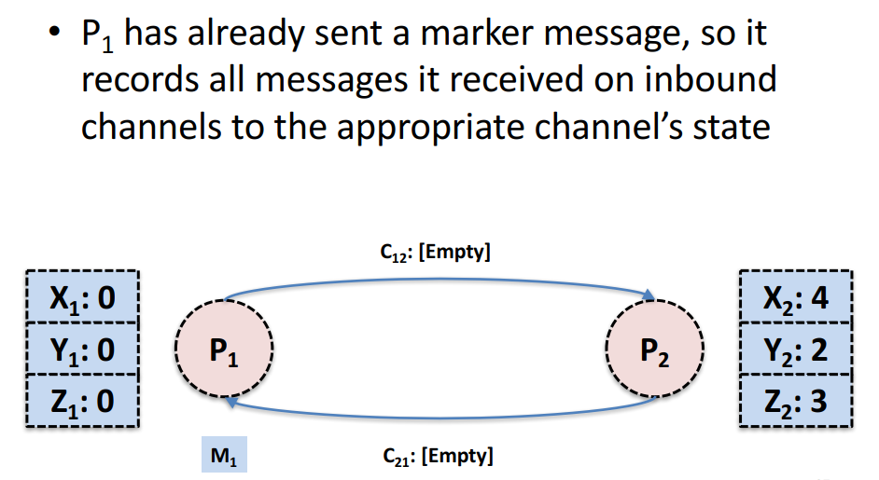
Chandy-Lamport Algorithm

Slide 73
Multicast

Slide 74
Multicast
FIFO or sender ordered multicast
Messages are delivered in the order they were sent (by any single sender)
TCP: sequence number
Causal order multicast
Total order (or atomic) multicast

Slide 75
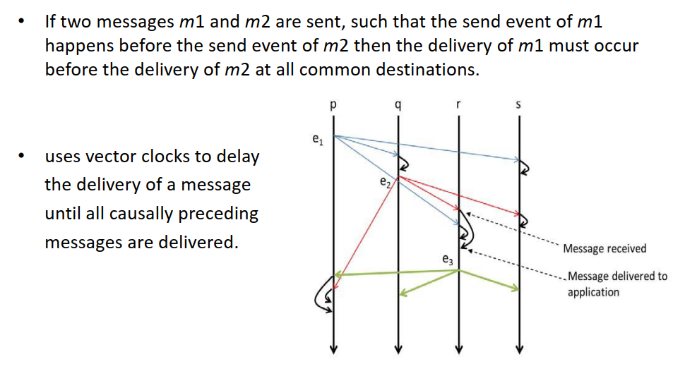
Causal Order Multicast

Slide 76
The Consensus Probelm

Slide 77
The Consensus Problem
Consensus is a fundamental distributed systems problem that involves several processes agreeing on a value in the presence of failure. – Communication is reliable, but sites may fail either by crashing or even maliciously.
A single coordinator, or General, which sends a binary value to n - 1 participants such that: – Agreement. All correct participants agree on same value. – Validity. If the general is correct, every participant agrees on the value the general has sent.

Slide 78
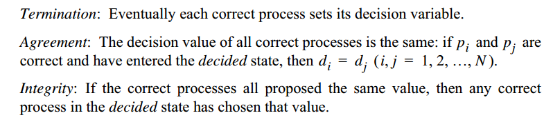
The Consensus Problem
If no process fails, the solution is straight-forward
Each process collect all values (v1, v2, …, vn) from all processes
Set decision, v = majority(v1, v2, …, vn)
Can also run: min or max over (v1, v2, …, vn)

Slide 79
The Consensus Problem
Possible
With one or more faulty processes
Solution:
Basic idea: All processes exchange (multicast) what other processes tell them in several rounds
Proof: to reach consensus with f failures, the algorithm needs to run in f + 1 rounds
Basic idea: if A and B do not agree on value X, then some other process C, did send X to A, but not to B.
Requires 1 failure in each round, so f+1 fails. Contradiction!

Slide 80
Variants of Consensus Problem
Consensus Problem (C)
Each process propose a value
All processes agree on a single value
Byzantine General Problem (BG)
Process fails arbitrarily, byzantine failure
Still processes need to agree
Interactive Consistency (IC)
Each process propose its value
All processes agree on the vector

Slide 81

Byzantine General Problem
attack
attack
attack
attack
retreat
attack

Slide 82
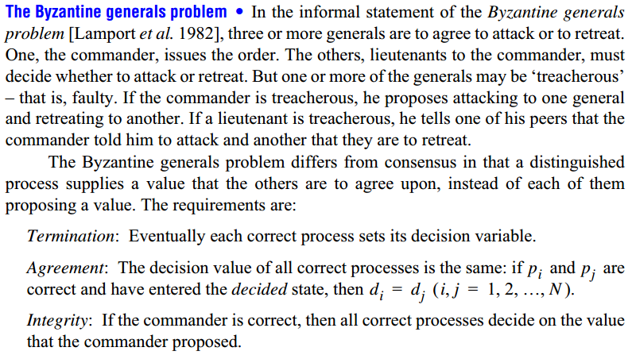
Byzantine General Problem

Slide 83
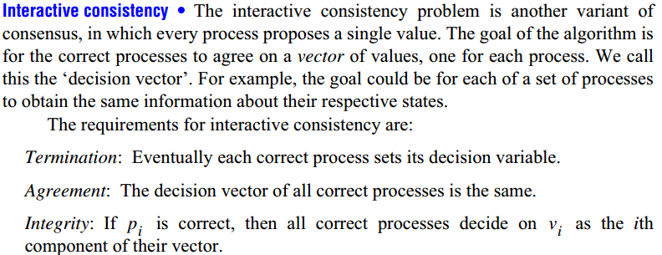
Interactive Consistency

Slide 84
Relation Among The Variants
Let’s consider the following solutions
C_{i} (v₁, v₂, …….., v_{N}) returns the decision value p_{i} in a run of the solution to the consensus problem, where v₁, v₂, …….., v_{N} are the values that the process proposed
BG_{i}(j, v) returns the decision value of p_{i} in a run of the solution to the Byzantine generals problem, where p_{j}, the commander, proposes the value v.
IC_{i} (v₁, v₂, …….., v_{N})[j] returns the jth value in the decision vector of p_{i} in a run of the solution to the interactive consistency problem, where v₁, v₂, …….., v_{N} are the values that the processes proposed.

Slide 85
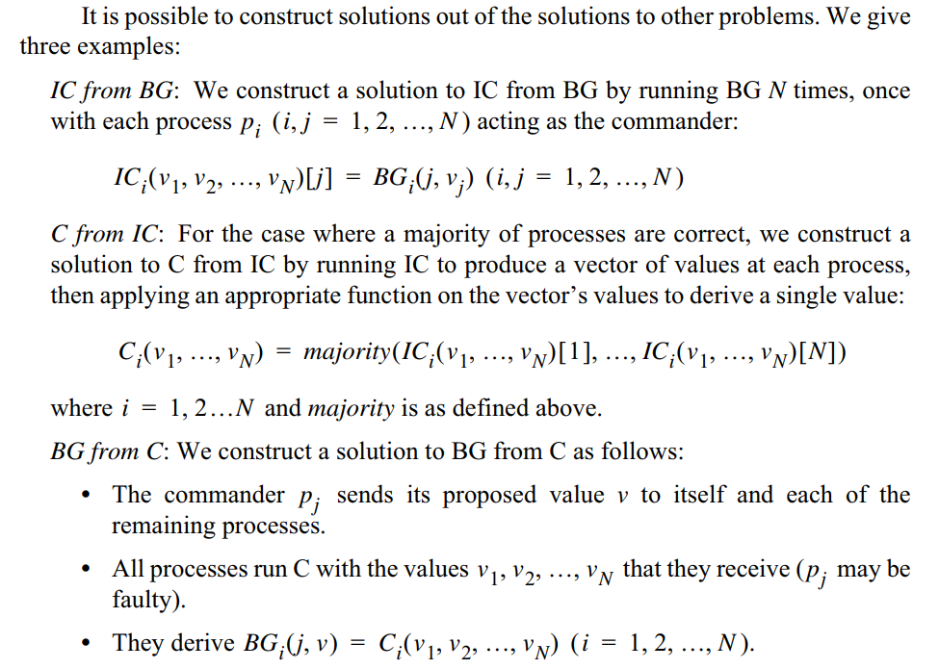
Relation Among The Variants

Slide 86
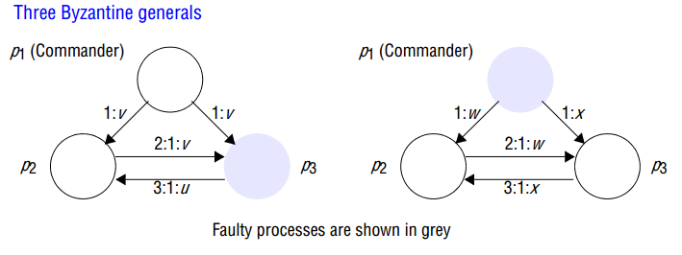
BG in Synchronous System
(v, u)
(x, w)
(x, w)
3 process can’t agree, if one process is faulty
N ≥ 3f +1 process can agree on at most f failures
Message complexity: O(N^f)

Slide 87
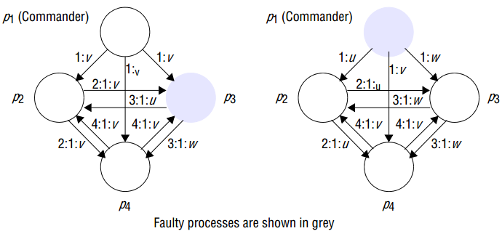
BG in Synchronous System

Slide 88
BG vs C
All consensus solution involves multiple round of exchanging values proposed/hold by others
BG is strictly harder than C
In C, faulty processes fail and do not participate in exchanging messages
In BG, faulty processes are alive and send different values to different ones, in diff rounds
C is possible for any N > f processes, with f faulty process, in f+1 rounds
BG is possible for N > 3f
N value, f faulty, N-f value for majority, skip faulty values
(N-f)/2 > f, so N > 3f

Slide 89
BG in Asynchronous System
Impossible!!
Even with one faulty process
Main problem: A failed process can’t be differentiated from a slow one
Needs further discussions!

Slide 90
The Paxos Algorithm

Slide 91
The Paxos Algorithm
L. Lamport, The Part-Time Parliament, September 1989
Aegean island of Paxos
A part-time parliament
Goal: determine the sequence of decrees passed
Lamport related their protocol to fault-tolerant distributed systems

Slide 92
The Paxos Algorithm
“In fact, it is among the simplest and most obvious of distributed algorithms.”
- Leslie Lamport

Slide 93
The Paxos Algorithm
It actually IS simple
Lamport walks through the algorithm
Distributed consensus problem
Group of processes must agree on a single value
Value must be proposed
After value is agreed upon, it can be learned

Slide 94
Safety Requirements
Only a value which has been proposed can be chosen
Only a single value can be chosen
A process never learns a value unless it was actually chosen

Slide 95
3 Types of Agents
The Paxos Algorithm
Proposers
Acceptors
Learners
Assumption: asynchronous, non-byzantine model

Slide 96
The Paxos Algorithm – Phase 1
(a) proposers send PREPARE(n) to acceptors
(b) acceptors response:
if n is larger than any other
send the value v of the highest-numbered accepted proposal, if it exists
this is a “promise” to not accept anything less than n
if acceptor already responded to message greater than n
Do nothing

Slide 97
The Paxos Algorithm – Phase 2
(a) If the proposer gets responses from a majority, sends ACCEPT(n, v) to acceptors
v is the value of the highest-numbered accepted proposal, or a new value
(b) An acceptor accepts the ACCEPT(n, v) if it did not respond to a higher-numbered PREPARE(n’) message

Slide 98
The Paxos Algorithm
Every process is acceptor, proposer, and learner
A leader is elected to be the distinguished proposer and learner
Distinguished proposer to guarantee progress
Avoid dueling proposers
Distinguished learner to reduce too many broadcast messages

Slide 99
Example: Prepare
PREPARE(10)
PREPARE(10)
ACCEPT(5, “A”)
Highest Accept:
(5, “A”)
Highest Prepare:
(15)
Highest Accept:
(5, “A”)
Highest Prepare:
(8)
Highest Accept:
(5, “A”)
Highest Prepare:
(10)

Slide 100
Example: Accept
ACCEPT(10, “A”)
ACCEPT(10, “A”)
YES
Highest Accept:
(5, “A”)
Highest Prepare:
(15)
Highest Accept:
(5, “A”)
Highest Prepare:
(10)
Highest Accept:
(10, “A”)
Highest Prepare:
(10)

Slide 101
Example
ACCEPT(10, “A”)
ACCEPT(11, “A”)
PREPARE(10)
PREPARE(12)
PREPARE(11)
PREPARE(13)
ACCEPT(5, “A”)
ACCEPT(5, “A”)
Highest Accept:
(5, “A”)
Highest Prepare:
(8)
Highest Accept:
(5, “A”)
Highest Prepare:
(10)
Highest Accept:
(5, “A”)
Highest Prepare:
(11)
Highest Accept:
(5, “A”)
Highest Prepare:
(12)
Highest Accept:
(5, “A”)
Highest Prepare:
(13)

Slide 102
The CAP Theorem

Slide 103

The CAP Theorem
Conjectured by Prof. Eric Brewer at PODC (Principle of Distributed Computing) 2000 keynote talk
Described the trade-offs involved in distributed system
It is impossible for a web service to provide following three guarantees at the same time:
Consistency
Availability
Partition-tolerance

Slide 104
The CAP Theorem
Consistency:
All nodes should see the same data at the same time
Availability:
Node failures do not prevent survivors from continuing to operate
Partition-tolerance:
The system continues to operate despite network partitions
A distributed system can satisfy any two of these guarantees at the same time but not all three

Slide 105
The CAP Theorem
C
A
P

Slide 106
The CAP Theorem
The future of databases is distributed (Big Data Trend, etc.)
CAP theorem describes the trade-offs involved in distributed systems
A proper understanding of CAP theorem is essential to making decisions about the future of distributed database design
Misunderstanding can lead to erroneous or inappropriate design choices

Slide 107
The CAP Theorem
The Relational Database is built on the principle of ACID (Atomicity, Consistency, Isolation, Durability)
It implies that a truly distributed relational database should have availability, consistency and partition tolerance.
Which unfortunately is impossible …

Slide 108
The CAP Theorem
The Relational Database is built on the principle of ACID (Atomicity, Consistency, Isolation, Durability)
It implies that a truly distributed relational database should have availability, consistency and partition tolerance.
Which unfortunately is impossible …

Slide 109
The CAP Theorem
Coda Hale, Yammer software engineer:
“Of the CAP theorem’s Consistency, Availability, and Partition Tolerance, Partition Tolerance is mandatory in distributed systems. You cannot not choose it.”
http://codahale.com/you-cant-sacrifice-partition-tolerance/

Slide 110
The CAP Theorem
Werner Vogels, Amazon CTO
“An important observation is that in larger distributed-scale systems, network partitions are a given; therefore, consistency and availability cannot be achieved at the same time.”
http://www.allthingsdistributed.com/2008/12/eventually_consistent.html

Slide 111
The CAP Theorem
Daniel Abadi, Co-founder of Hadapt
So in reality, there are only two types of systems ... I.e., if there is a partition, does the system give up availability or consistency?
http://dbmsmusings.blogspot.com/2010/04/problems-with-cap-and-yahoos-little.html

Slide 112
Consistency or Availability?
Consistency and Availability is not “binary” decision
AP systems relax consistency in favor of availability – but are not inconsistent
CP systems sacrifice availability for consistency- but are not unavailable
This suggests both AP and CP systems can offer a degree of consistency, and availability, as well as partition tolerance

Slide 113
Types of Consistency
Strong Consistency
After the update completes, any subsequent access will return the same updated value.
Weak Consistency
It is not guaranteed that subsequent accesses will return the updated value.
Eventual Consistency
Specific form of weak consistency
It is guaranteed that if no new updates are made to object, eventually all accesses will return the last updated value (e.g., propagate updates to replicas in a lazy fashion)

Slide 114
Types of Eventual Consistency
Causal consistency
Read-your-write consistency
Session consistency
Monotonic read consistency

Slide 115
Reference
Distributed Systems: Concepts and Design (5th Edition) George Coulouris, Jean Dollimore, Tim Kindberg, Gordon Blair
Chapter 14.4, 14.5
Chapter 15.2, 15.3, 15.5

Slide 116
THANK YOU!!!

